Slide 1
Exploring quantmod
Allison Roderick

Slide 2
quantmod
quantmod allows for easy access to APIs such as Federal Reserve Bank of St. Louis, Yahoo! Finance, Google Finance, and more
I chose to use this package and its functions to plot some of Microsoft’s financial data
I mirrored the examples on the website:
https://www.quantmod.com/examples/intro/

Slide 3
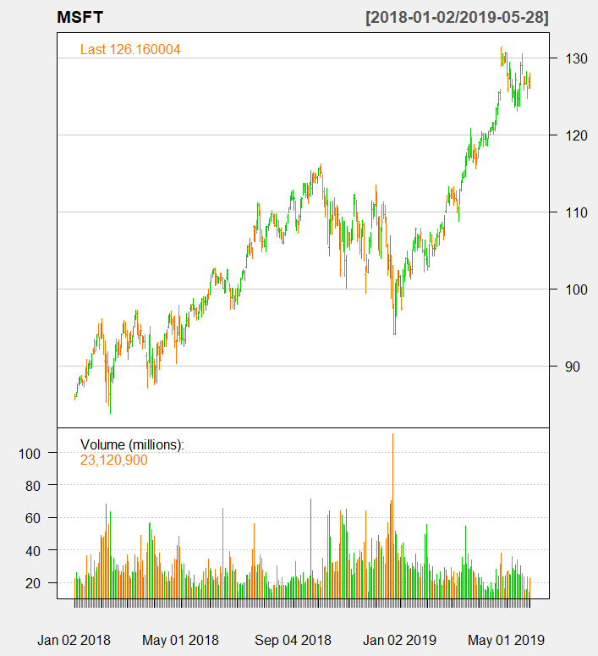


quantmod in action

